Slide 1
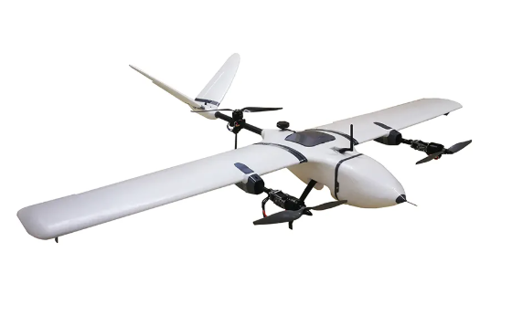
Vertical Take-off Landing (VTOL) Aircraft
Metin Öz Harun Üner
2019405000 2019405207

Slide 2
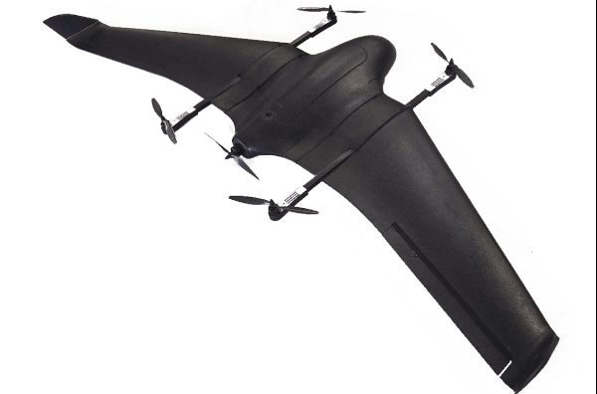
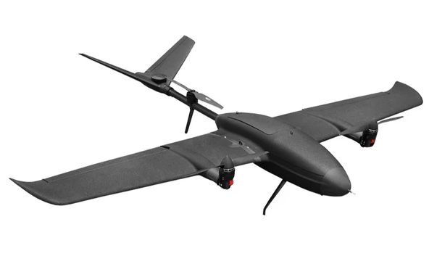
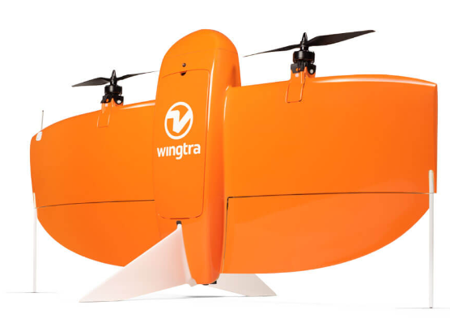
What is VTOL?
-VTOL is a type of aircraft that can take off and land vertically and also perform forward flight like a fixed wing.
-The Main Types of VTOLs :
Quad-in-Plane VTOL drones
Tail-sitter VTOL drones
Tiltrotor VTOL drones

Slide 3
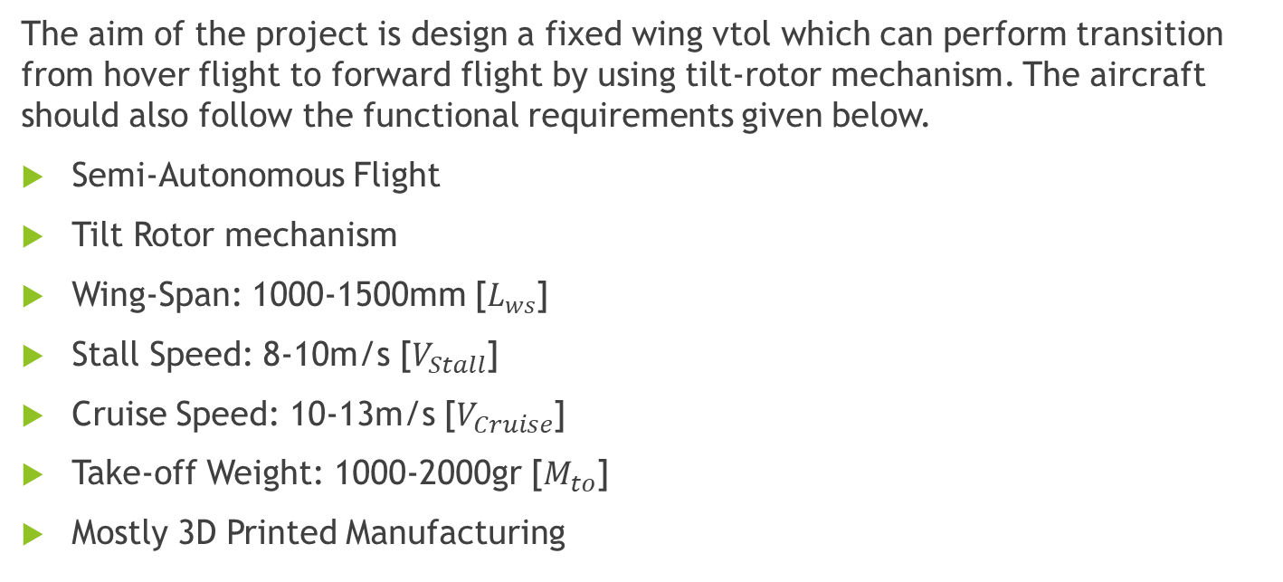
Problem Definition and Functional Requirements :
The aim of the project is design a fixed wing vtol which can perform transition from hover flight to forward flight by using tilt-rotor mechanism. The aircraft should also follow the functional requirements given below.
Semi-Autonomous Flight
Tilt Rotor mechanism
Wing-Span: 1000-1500mm [$L_{ws}$]
Stall Speed: 8-10m/s [$V_{Stall}$]
Cruise Speed: 10-13m/s [$V_{Cruise}$]
Take-off Weight: 1000-2000gr [$M_{to}$]
Mostly 3D Printed Manufacturing

Slide 4
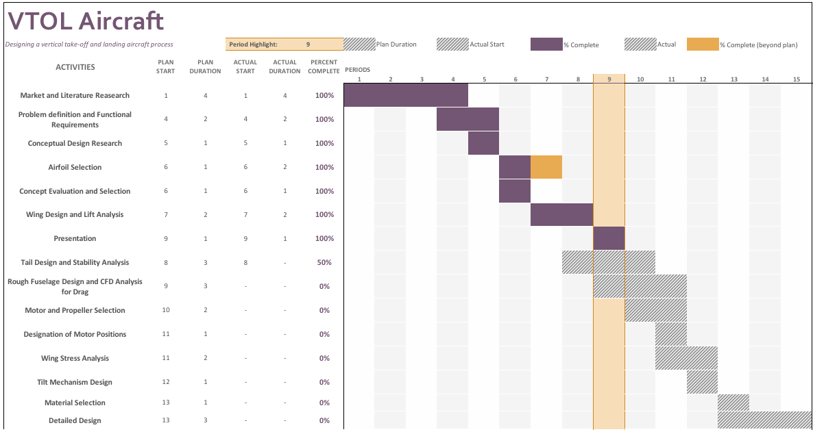

Slide 5
Concepts of Fixed Wing VTOLs
Concept 1
3 rotors
2 front rotors are able to tilt in y-axes
Only 1 (Rear) passive rotor causes extra drag during horizontal flight
Quite Stable for vertical flight (3-point stability triangle)
Less bending moment on wings

Slide 6
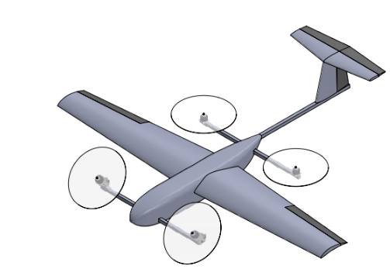
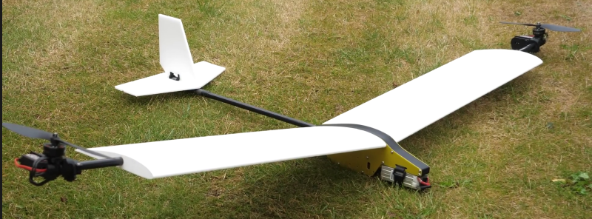
Concept 2
4 rotors, 2 of them (Front) are able to tilt
2 passive rotor causes extra drag during horizontal flight
Extra weight for rotor arm tubes
Most stable concept for vertical flight
Concept 3
2 rotors, both are able to tilt
No passive rotor, no extra drag
Highest bending moment on wing
Least stable concept for vertical flight

Slide 7
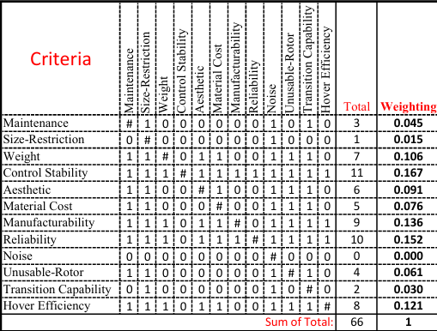
Binary Dominance Matrix

Slide 8
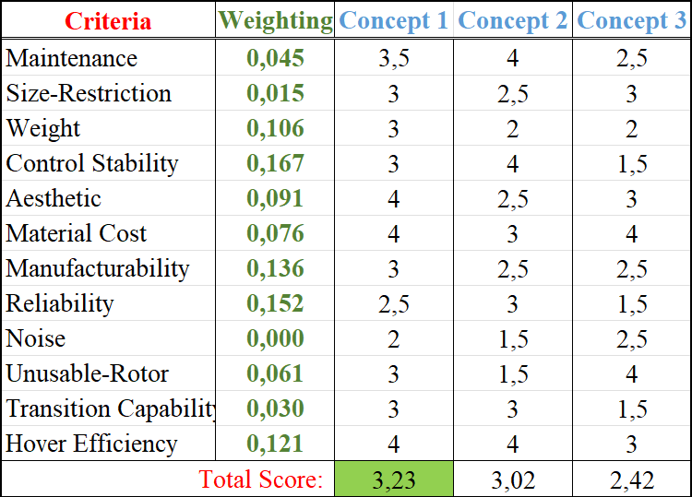
Concept Evaluation

Slide 9
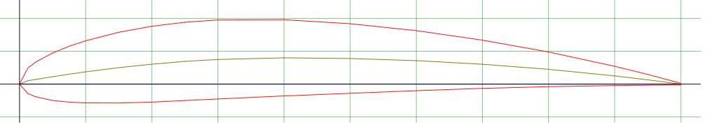
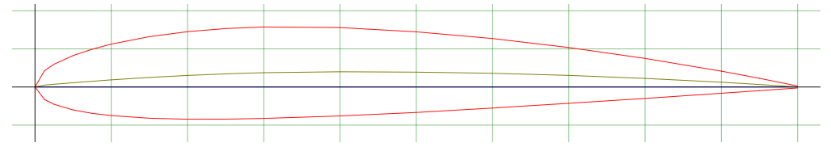
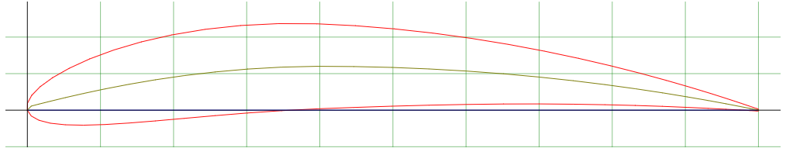

Airfoil Selection
airfoiltools.com web tool is used to select airfoil, compare and understand their strengths for our design.
NACA 4412
NACA 2412
NACA 6412
Low Drag Coefficient
Low Chamber-Ease of Manufacturing
High $C_{L}/C_{D}$ Ratio

Slide 10
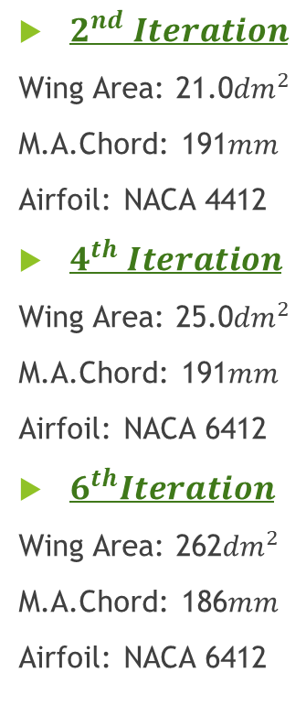
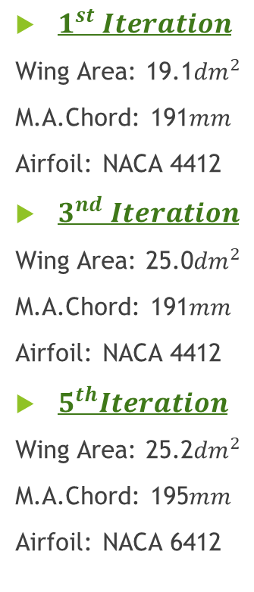

XFLR-5 Wing Design and Analysis
$1^{st} Iteration$
Wing Area: 19.1${dm}^{2}$
M.A.Chord: 191$mm$
Airfoil: NACA 4412
$3^{nd} Iteration$
Wing Area: 25.0${dm}^{2}$
M.A.Chord: 191$mm$
Airfoil: NACA 4412
$5^{th}Iteration$
Wing Area: 25.2${dm}^{2}$
M.A.Chord: 195$mm$
Airfoil: NACA 6412
Increase of wing area
$2^{nd} Iteration$
Wing Area: 21.0${dm}^{2}$
M.A.Chord: 191$mm$
Airfoil: NACA 4412
$4^{th} Iteration$
Wing Area: 25.0${dm}^{2}$
M.A.Chord: 191$mm$
Airfoil: NACA 6412
$6^{th}Iteration$
Wing Area: 262${dm}^{2}$
M.A.Chord: 186$mm$
Airfoil: NACA 6412
Increase of wing area
Change to higher $C_{L}Airfoil$
Increase of Root Chord
Addition of winglets

Slide 11
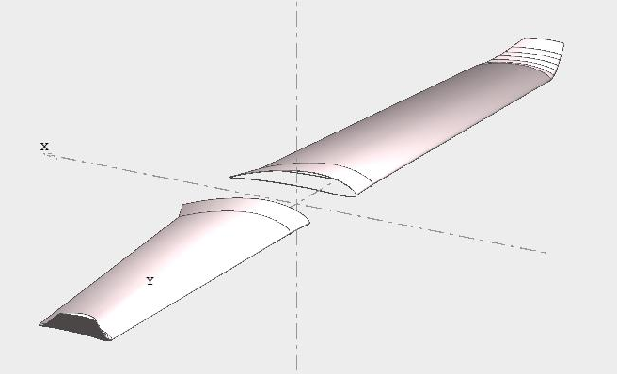
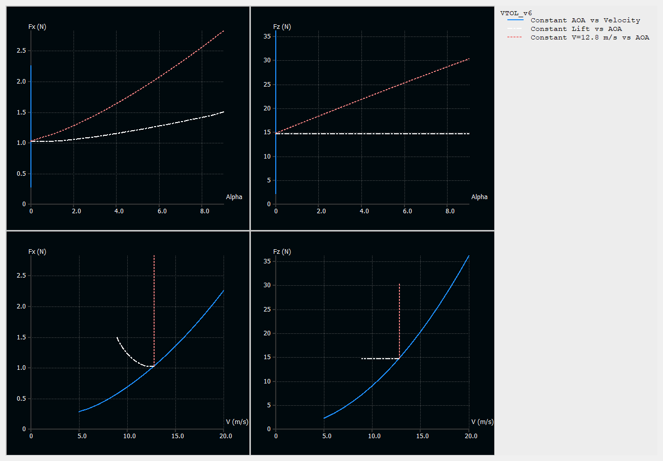
Final Design and Results
XFLR-5
6 Iteration is performed for
different geometries
Final Iteration:
-Wing Span: 1640mm
-M.A.C: 186mm
-Stall Speed: 8.9m/s @ α=9˚
-Cruse Speed: 13m/s @ α=0˚
(for 1500 g take-off weight)

Slide 12
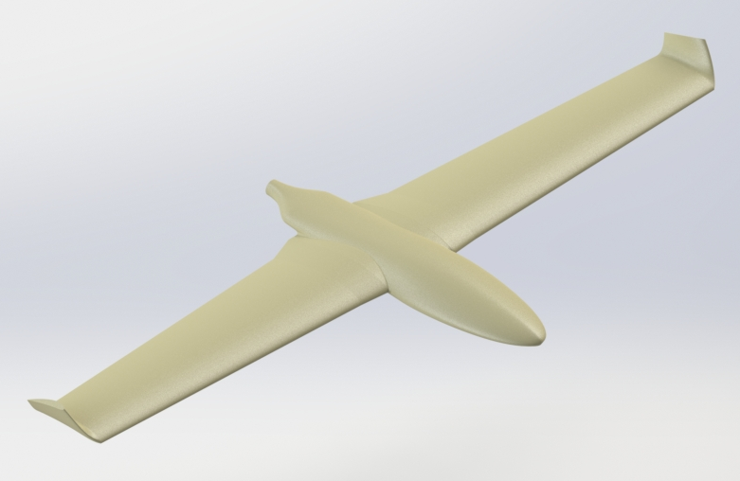
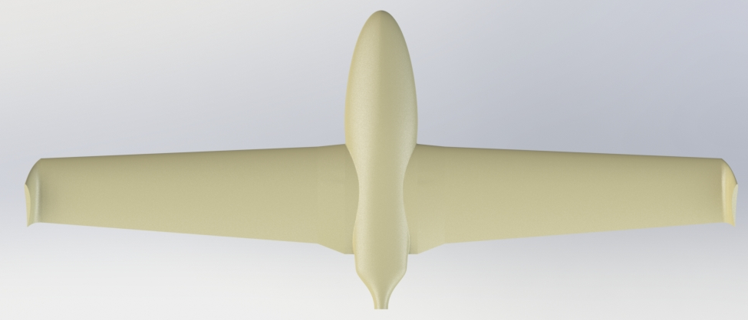
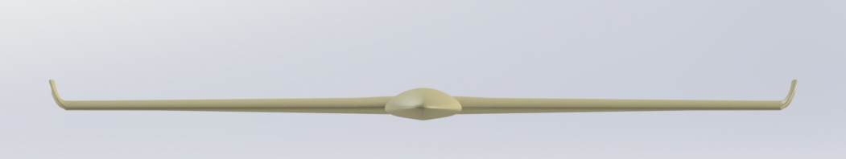
Furthermore

